Slide 1
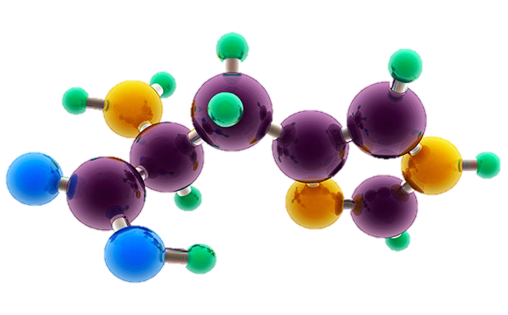
AP Chemistry
Exam Review

Slide 2
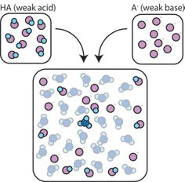
Big Idea #6
Equilibrium

Slide 3
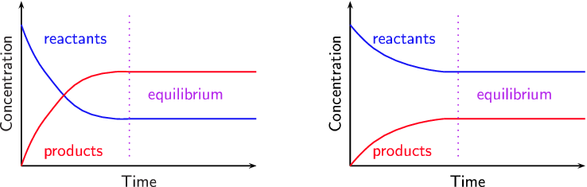
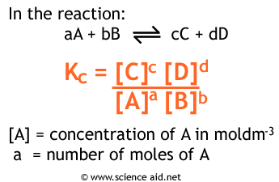
What is chemical equilibrium?
Source
Systems that have reached the state where the rates of the forward reaction and the reverse reaction are constant and equal.
It is a dynamic process where reactants continuously form products and vice versa, but the net amounts of reactants and products remain constant.
The proportions of products and reactants formed in a system at a specific temperature that has achieved equilibrium is represented by K, the equilibrium constant.
Video
LO 6.1: Given a set of experimental observations regarding processes that are reversible, construct an explanation that connects the observations to the reversibility of the underlying chemical reactions or processes.

Slide 4
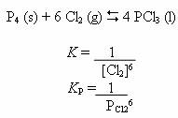
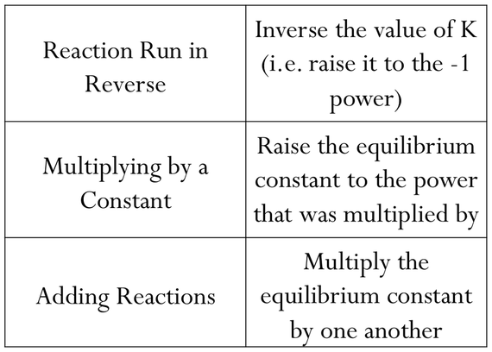
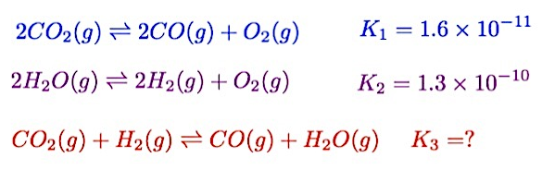
Manipulating Q and K
Source
K (equilibrium constant) represents the relative amounts of products to reactants at equilibrium at a given temperature.
Q (reaction progress) describes the relative amounts of products to reactants present at any point in the reaction at a given temperature.
Q and K only include substances that are gases or in aqueous solutions. No solids or liquids are ever included in these expressions.
Video
Similar reactions will have related K values at the same temperature.
Click reveals answer.
2.9
LO 6.2: The student can, given a manipulation of a chemical reaction or set of reactions (e.g., reversal of reaction or addition of two reactions), determine the effects of that manipulation on Q or K.

Slide 5
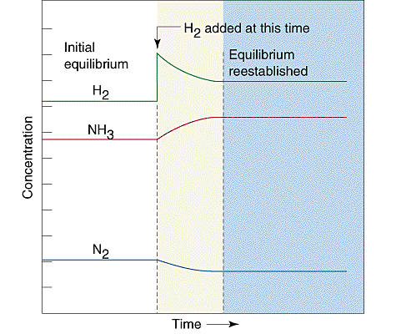
Kinetics and Equilibrium
Source
Kinetics examines the rate at which reactions proceed. Rate laws are used to describe how reactant concentrations affect a reaction’s rate. Rate constants (k) in rate law expressions are determined experimentally at a given temperature.
Equilibrium describes the state at which the rates of the forward reaction and the reverse reaction are constant and equal.
If the rates are initially unequal (the system is not at equilibrium), the faster direction depletes its reactants, which feeds back to slow down that direction.
At the same time, the slower direction accumulates its reactants, speeding up the slower direction.
Video
These loops continue until the faster rate and the slower rate have become equal.
In the graph to the right, after equilibrium has been achieved, additional hydrogen gas is added to the system. The system then consumes both H₂ and N₂ to form additional NH₃ molecules, eventually reestablishing equilibrium.
LO 6.3: The student can connect kinetics to equilibrium by using reasoning, such as LeChatelier’s principle, to infer the relative rates of the forward and reverse reactions.

Slide 6
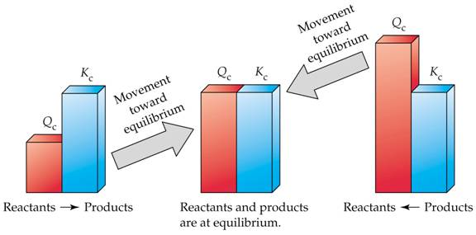
Q vs. K
Source
Equilibrium is reacted when the rates of the forward reaction and the rates of the reverse reaction are equal, which is when Q is equal to K.
Comparing Q to K enables us to determine if a chemical system has achieved equilibrium or will need to move towards reactants or products to reach equilibrium.
- if Q < K, the reaction will proceed in the forward direction until Q = K
- if Q > K, the reaction will proceed in the reverse direction until Q = K
- if Q = K, the reaction is at equilibrium, and the concentrations of
reactants and products remain constant
Video
LO 6.4: Given a set of initial conditions and the equilibrium constant, K, use the tendency of Q to approach K to predict and justify the prediction as to whether the reaction will proceed toward products or reactants as equilibrium is approached.

Slide 7
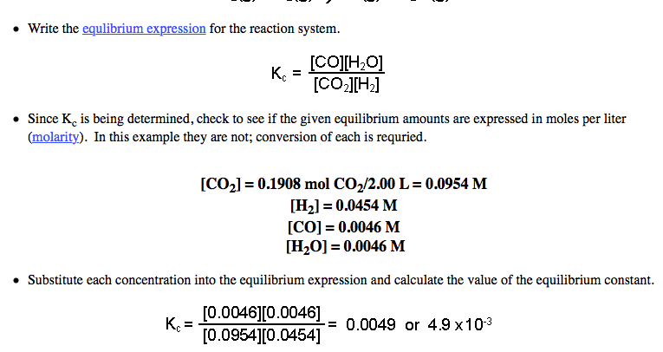

Calculating K
Source
Source
Equilibrium constants can be determined using experimental concentrations of reactants and products at equilibrium.
Steps:
1) Write an equilibrium expression
2) Determine equilibrium molar concentrations or partial pressures for all
substances in expression
3) Substitute quantities into equilibrium expression and solve.
Video
Example: Calculate K for the following system if 0.1908 mol CO₂, 0.0908 mol H₂, 0.0092 CO, and 0.0092 mol H₂O vapor are present in a 2.00 L vessel at equilibrium:
Click reveals answer and explanation.
LO 6.5: The student can, given data (tabular, graphical, etc.) from which the state of a system at equilibrium can be obtained, calculate the equilibrium constant, K.

Slide 8
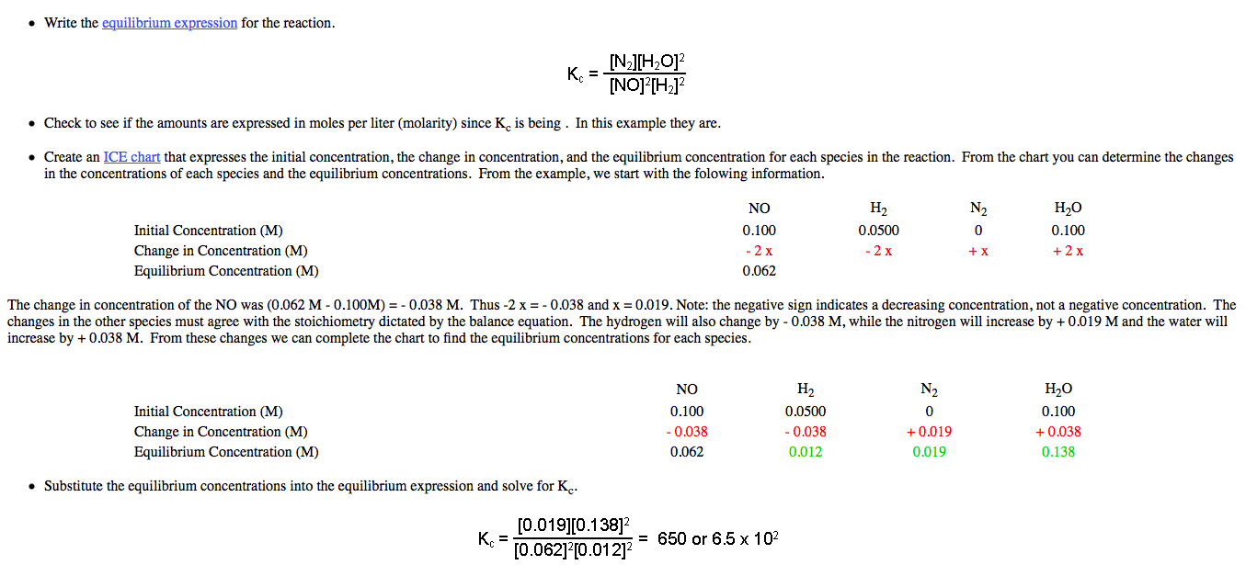
Calculating K
Source
Source
Equilibrium constants can also be determined from both initial and equilibrium concentrations using an ICE chart.
Steps:
1) Write an equilibrium expression
2) Determine molar concentrations or partial pressures for all
substances in expression
3) Determine equilibrium concentrations or partial pressures using an ICE
chart.
4) Substitute quantities into equilibrium expression and solve.
Video
Example: Initially, a mixture of 0.100 M NO, 0.050 M H2, and 0.100 M H2O was allowed to reach equilibrium. No N2 was present initially. At equilibrium, NO had a concentration of 0.062 M. Determine the value of K for the reaction:
Click reveals answer and explanation.
LO 6.5: Given data (tabular, graphical, etc.) from which the state of a system at equilibrium can be obtained, calculate the equilibrium constant, K.

Slide 9
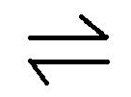
Calculating Equilibrium Concentrations with K
Source
Equilibrium concentrations can be calculated using a K expression, the K constant, and initial concentrations or partial pressures of substances.
Steps:
1) Write an equilibrium expression for the reaction
2) Set up an ICE table and fill in “initial” quantities
3) Determine “changes” in the system in terms of x needed for the
system to achieve equilibrium
4) Determine the “equilibrium” values for the system by adding the
“initial” and “change” values together
5) Solve for x using the K expression and the “equilibrium” values.
Verify if the change in initial concentrations is negligible using the
5% rule.
6) Determine all equilibrium quantities using the value of x
Example: Given the following reaction at 1373 K: Cl₂(g) 2Cl(g), determine the equilibrium partial pressures of all species if
0.500 atm Cl₂ is present initially. K = 1.13x10⁻⁴ for the reaction
at 1373 K.
Video
Click reveals answer.
0.497 atm Cl₂ and
0.00752 atm Cl
LO 6.6: Given a set of initial conditions (concentrations or partial pressures) and K, use stoichiometric relationships and the law of mass action (Q equals K at equilibrium) to determine qualitatively and/or quantitatively the conditions at equilibrium for a system involving a single reversible reaction.

Slide 10
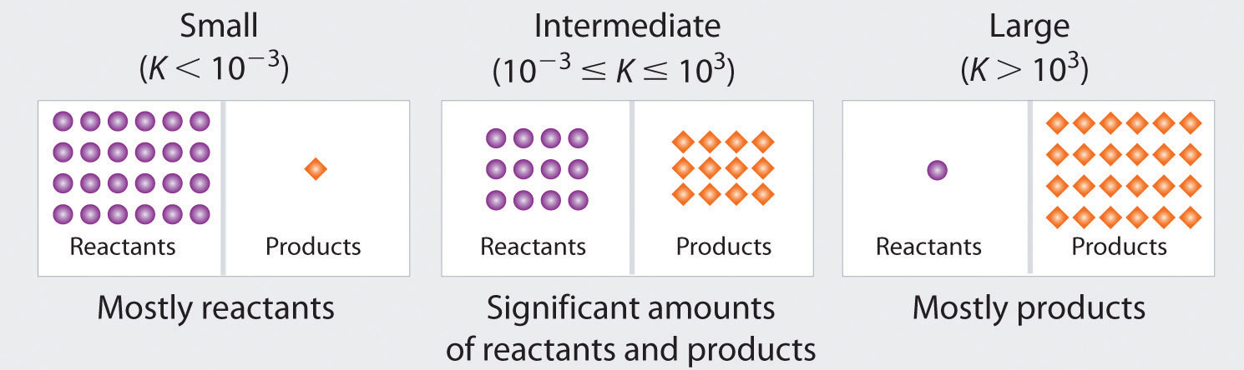
Magnitude of K
Source
For many reactions involving aqueous solutions, K is either very large (favoring the forward reaction) or very small (favoring the reverse reaction)
The size of K can be used to describe the relationship between the numbers of reactant and product particles present at equilibrium.
Video
LO 6.7: The student is able, for a reversible reaction that has a large or small K, to determine which chemical species will have very large versus very small concentrations at equilibrium.

Slide 11
Le Chatelier’s Principle
Animation
Source
This principle is used to describe changes that occur in a system that has achieved equilibrium. There are three factors that can cause shifts in a system at equilibrium: concentration, pressure, and temperature.
Change | Direction System Shifts to Reestablish Equilibrium
Adding a reactant | Shifts towards products
Adding a product | Shifts towards reactants
Removing a reactant | Shifts towards reactants
Removing a product | Shifts towards products
Increasing pressure (decreasing volume) | Shifts toward less gas molecules
Decreasing pressure (increasing volume) | Shifts towards more gas molecules
Adding an inert gas | No effect
Increasing the temperature | Endothermic: shifts towards products Exothermic: shifts towards products
Decreasing the temperature | Endothermic: shifts towards reactants Exothermic: shifts towards products
Video
LO 6.8: The student is able to use LeChatelier’s principle to predict the direction of the shift resulting from various possible stresses on a system at chemical equilibrium.

Slide 12
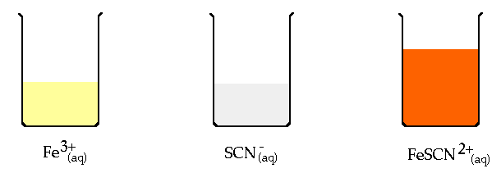
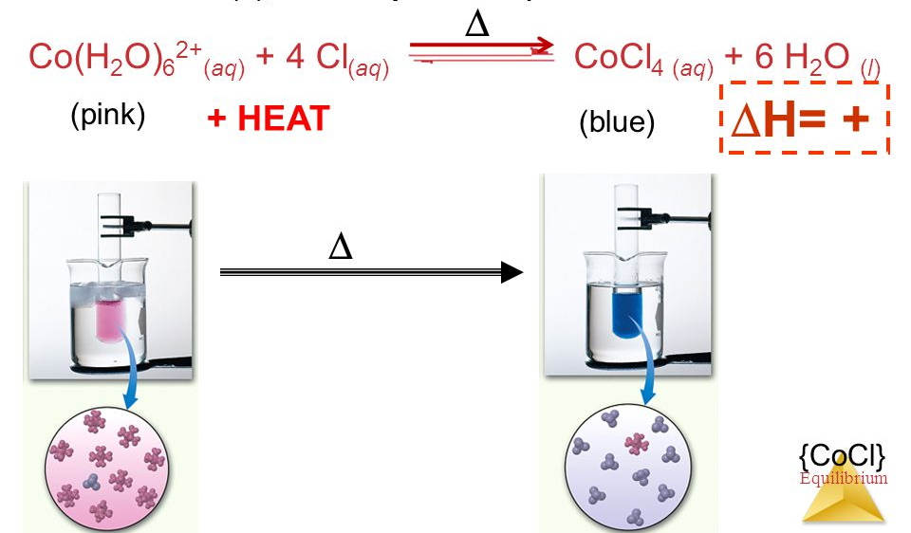
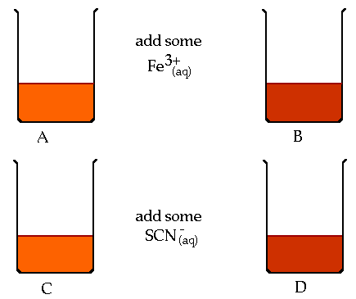
Experimentally Examining
Le Chatelier’s Principle
Animation
Source
Systems at equilibrium can be examined using Le Chatelier’s Principle by measuring its properties, including pH, temperature, solution color (absorbance)
Video
Fe⁺³(aq) + SCN⁻(aq) FeSCN²⁺(aq)
LO 6.9: The student is able to use LeChatelier’s principle to design a set of conditions that will optimize a desired outcome, such as product yield.

Slide 13
Changes to Q and K for a System at Equilibrium
Animation
Some changes that occur to a system at equilibrium will affect the reaction’s current position (Q). Others will affect the value of K
Change | Direction System Shifts to Reestablish Equilibrium | Effect on Q or K
Adding a reactant | Shifts towards products | Q decreases
Adding a product | Shifts towards reactants | Q increases
Removing a reactant | Shifts towards reactants | Q increases
Removing a product | Shifts towards products | Q decreases
Increasing pressure (decreasing volume) | Shifts toward less gas molecules | Q can increase, decrease, or remain constant depending on ratio of gas molecules between reactants and products
Decreasing pressure (increasing volume) | Shifts towards more gas molecules
Adding an inert gas | No effect | Q doesn’t change
Increasing the temperature | Endothermic: shifts towards products Exothermic: shifts towards reactants | Endothermic: K increases Exothermic: K decreases
Decreasing the temperature | Endothermic: shifts towards reactants Exothermic: shifts towards products | Endothermic: K decreases Exothermic: K increases
Video
Source
LO 6.10: The student is able to connect LeChatelier’s principle to the comparison of Q to K by explaining the effects of the stress on Q and K.

Slide 14



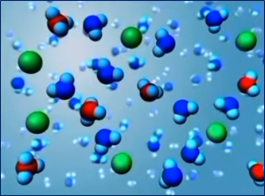
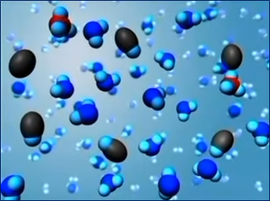
Acid/Base Particulates
Source
Select Acid-Base Ionization
Video
Strong: Since K_{a} = $\frac{\left[H3O˖\right][A˗]}{[HA]}$>>1, at equilibrium strong acids are molecules that essentially ionize to completion in aqueous solution, disassociating into H₃O⁺ ions and the additional anion.
Weak: Since K_{a} = $\frac{\left[H3O˖\right][A˗]}{[HA]}≪$1, at equilibrium weak acids are molecules that only partially ionize in aqueous solution, disassociating into few H₃O⁺ ions and the additional anion.
LO 6.11: The student can generate or use a particulate representation of an acid (strong or weak or polyprotic) and a strong base to explain the species that will have large versus small concentrations at equilibrium.

Slide 15
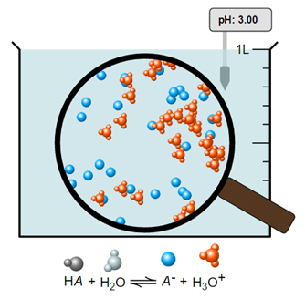
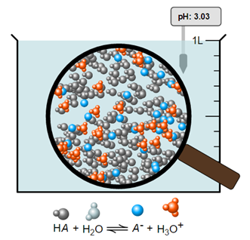
pH of Weak or Strong Acid
Source
Note the similar pH values of both monoprotic acids.
pH= 3.00
pH= 3.00
Video
This is a particulate picture of a weak acid whose [HA] = 1.00M and K_{a} = 1.00x10⁻⁶.
pH is a measure of the [H⁺] in solution. More moles of a weak acid are needed to achieve equivalent [H⁺] values of a strong acid of the same pH, since a weak acid only partially ionizes.
This is a particulate picture of a strong acid whose [HA] = 0.00100M.
Note the 100% ionization of this acid.
If similar volumes of both acids above were titrated with the same strong base, the weak acid would require a larger volume of base to reach its equivalence point.
LO 6.12: Reason about the distinction between strong and weak acid solutions with similar values of pH, including the percent ionization of the acids, the concentrations needed to achieve the same pH, and the amount of base needed to reach the equivalence point in a titration.

Slide 16
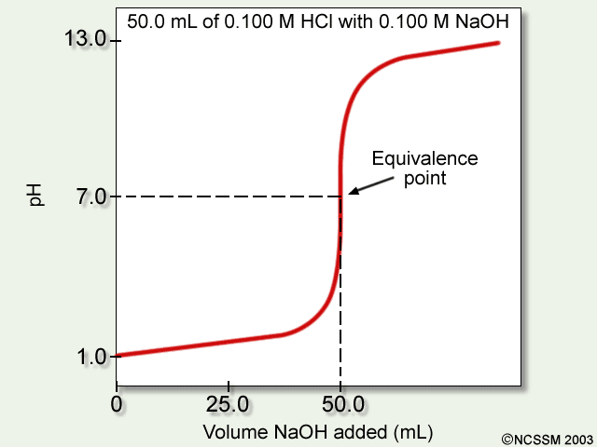
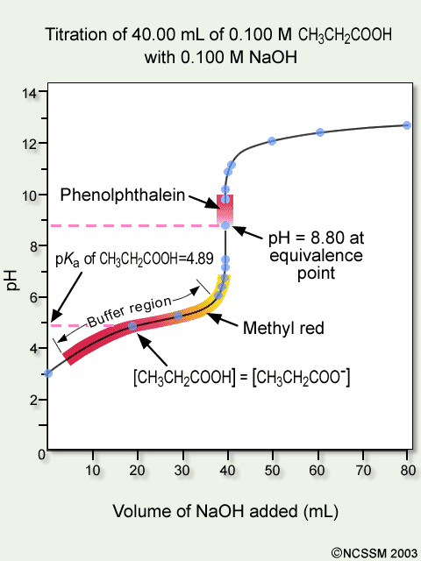
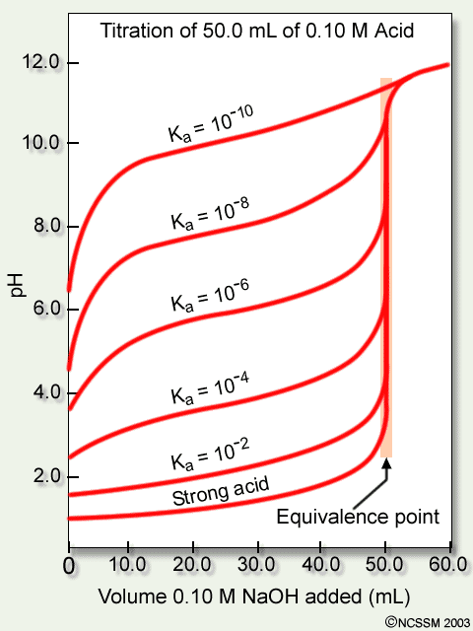
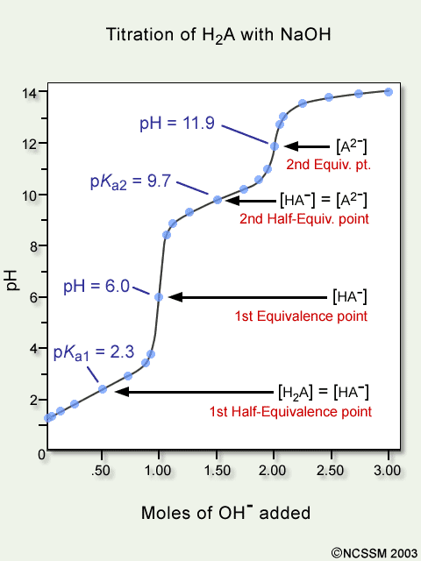
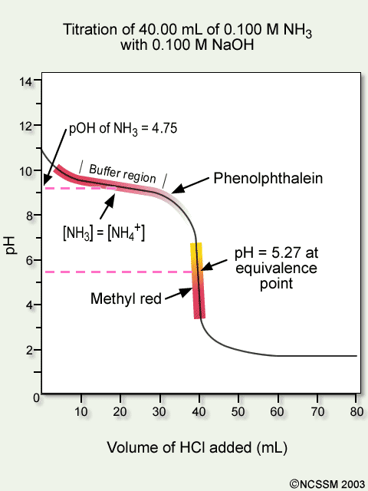
Titrations
Source
This illustration shows the titration curve of a strong acid with a strong base.
Video
This illustration shows the titration curve of
a weak acid with a strong base with indicator changes.
This illustration shows the titration curves
of several weak acids with a strong base
See Source link to review titration calculations.
This illustration shows the titration curve of a weak base with a strong acid with indicator changes.
This illustration shows the titration curve of a polyprotic weak acid with a strong base.
LO 6.13: The student can interpret titration data for monoprotic or polyprotic acids involving titration of a weak or strong acid by a strong base (or a weak or strong base by a strong acid) to determine the concentration of the titrant and the pK_{a} for a weak acid, or the pK_{b} for a weak base.

Slide 17
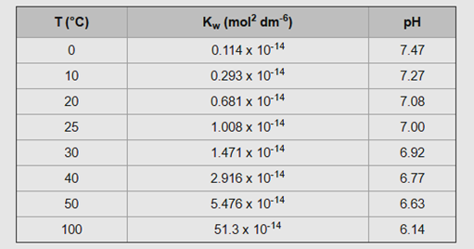


K_{w} and Temperature
Source
Video
E +
As T increases, pH of pure water decreases. The water is NOT becoming more acidic. A solution is only acidic if [H+] > [OH-].
At 50°C, the pH of pure water is 6.63, which is defined as “neutral”, when [H⁺] = [OH⁻]. A solution with a pH of 7 at this temperature is slightly basic b/c it is higher than the neutral value of 6.63.
The dissociation of water is endothermic. An increase of energy will shift the reaction to the right, increasing the forward reaction, and increase the value of K_{w}.
LO 6.14: The student can, based on the dependence of K_{w} on temperature, reason that neutrality requires [H⁺] = [OH⁻] as opposed to requiring pH = 7, including especially the application to biological systems.

Slide 18
Acid/Base Mixtures and its pH
Source
A 25 mL sample of hydrofluoric acid (HF) is titrated with 25 mL of 0.30M sodium hydroxide (NaOH). At the equivalence point of the titration, what would the pH of the solution be? Justify with a reaction.
pH < 7
pH = 7
pH > 7
pH = pK_{a}
Video
Click reveals answer and explanation.
The correct answer is “c” pH>7. At the equivalence point, the moles of acid equal the moles of base. The remaining species would be Na⁺ and F⁻. The conjugate base, F⁻ will hydrolyze with water, producing OH⁻ in solution: F⁻(aq) + H₂O(l)  HF(aq) + OH⁻(aq) Select the Source link to see more calculations in this titration.
LO 6.15: The student can identify a given solution as containing a mixture of strong acids and/or bases and calculate or estimate the pH (and concentrations of all chemical species) in the resulting solution.

Slide 19
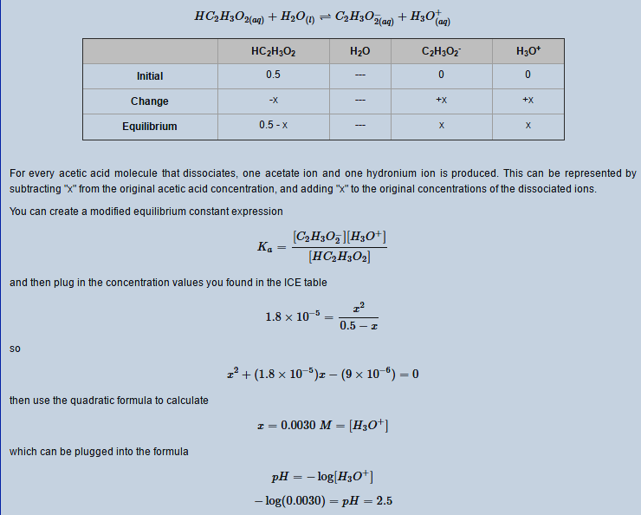
pH and Acid/Base Equilibria
Source
1st click reveals answer and explanation.
See Source link for more calculations.
1. Vinegar is 0.50M acetic acid, HC₂H₃O_{2,} with a K_{a} = 1.8 x 10⁻⁵. What would be the pH of this solution?
Video
2. Identify and compare the relative strengths of the two acids and the two bases in this neutralization reaction: OH⁻(aq) + NH₄⁺(aq)  H₂O(l) + NH₃(aq).
The correct formulation of acid strength is based on a comparison to the K_{a}'s of hydronium (=1) and water (= 1 x 10⁻¹⁴). Any acid that is stronger than hydronium (e.g. HCl) is a strong acid and its conjugate base (chloride) has no effect on pH because it does not hydrolyze in water. Any acid whose strength is between hydronium and water (e.g. ammonium) is a weak acid, and its conjugate is a weak base. Similarly, for bases, any base with K_{b} greater than that of hydroxide, which is = 1, (e.g., oxide ion as K₂O) is a strong base, and its conjugate acid (K⁺) has no effect on pH because it does not hydrolyze in water. Any base with K_{b} between that of hydroxide and water (= 1 x 10⁻¹⁴) is a weak base, and its conjugate is a weak acid (e.g., acetate).
2nd click reveals answer and explanation.
Answer: Hydroxide(OH⁻), and ammonia(NH₃) are the two bases, with ammonia being the weaker, while ammonium(NH₄⁺) and water are the acids, with water the weaker.
LO 6.16: The student can identify a given solution as being the solution of a monoprotic weak acid or base (including salts in which one ion is a weak acid or base), calculate the pH and concentration of all species in the solution, and/or infer the relative strengths of the weak acids or bases from given equilibrium. concentrations.

Slide 20
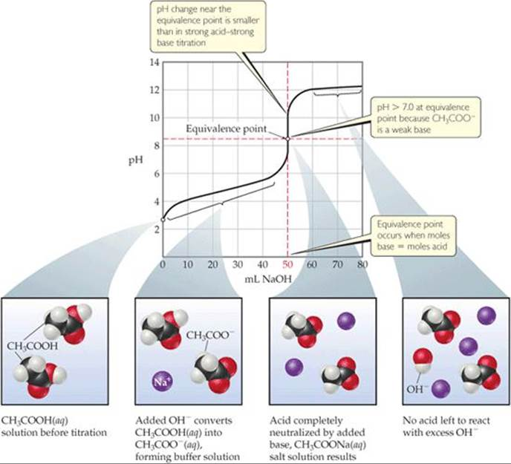
Acid/Base reaction species
Source
Ask yourself:
Is it strong? Weak? A salt? A buffer? What will it do in water?
See Source link for more details
Video
Deal w/strong A/B first. These will react to completion with the available species.
LO 6.17: The student can, given an arbitrary mixture of weak and strong acids and bases (including polyprotic systems), determine which species will react strongly with one another (i.e., with K>1) and what species will be present in large concentrations at equilibrium.

Slide 21
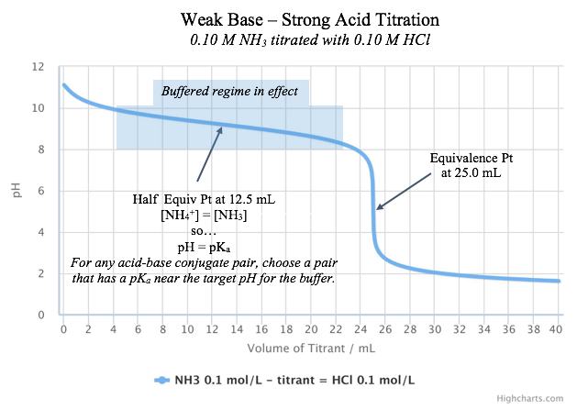
How to Build a Buffer:
Source
Estimating Buffer Capacity:
A buffer is only effective as long as it has sufficient amounts of both members of the conjugate acid-base pair to allow equilibrium to shift during a stress.
Getting the pH correct:
The pH of a buffer is primarily determined by the pKa of the weak acid in the conjugate acid-base pair.
When both species in the conjugate acid-base pair have equal concentrations, the pH of the buffer is equal to the pKa.
Choose a conjugate acid-base pair that has a pKa closest to the pH you desire and then adjust concentrations to fine tune from there.
Video
LO 6.18: The student can design a buffer solution with a target pH and buffer capacity by selecting an appropriate conjugate acid-base pair and estimating the concentrations needed to achieve the desired capacity.

Slide 22
Finding the Major Species
Source
A 50.0 mL sample of 0.50 M HC₂H₃O₂ is titrated to the half equivalence point with 25.0 mL of 0.50 M NaOH. Which of the following options shows the correct ranking of the molarities of the species in solution?
        (pKa for HC₂H₃O₂ is 4.7)
  a. [HC₂H₃O₂] > [C₂H₃O₂ ¹⁻] > [ H⁺ ] > [ OH⁻ ]
  b. [HC₂H₃O₂] = [C₂H₃O₂ ¹⁻] > [ H⁺ ] > [ OH⁻ ]
  c. [HC₂H₃O₂] > [C₂H₃O₂ ¹⁻] = [ H⁺ ] > [ OH⁻ ]
  d. [C₂H₃O₂ ¹⁻] > [HC₂H₃O₂] > [ OH⁻ ] > [ H⁺ ]
  Option B is correct.
  At the half equivalence point, the concentrations of the weak acid and its conjugate base are equal because the OH⁻ ion has reacted with half of the original acetic acid. The pH of the buffer is equal to the pKa at that point, so the [H+] is 10^{-4.7} which is far lower than the concentrations of the conjugates but far higher than the [OH-] which has a value of 10^{-9.3}.
Video
Click reveals answer and explanation.
LO 6.19: The student can relate the predominant form of a chemical species involving a labile proton (i.e., protonated/deprotonated form of a weak acid) to the pH of a solution and the pKa associated with the labile proton.

Slide 23
The Buffer Mechanism
Source
A buffer is able to resist pH change because the two components (conjugate acid and conjugate base) are both present in appreciable amounts at equilibrium and are able to neutralize small amounts of other acids and bases (in the form of H₃O⁺ and OH⁻) when they are added to the solution. Take, for example, a fluoride buffer made from hydrofluoric acid and NaF. A model fluoride buffer would contain equimolar concentrations of HF and NaF. Since they are a weak acid and a weak base, respectively, the amount of hydrolysis is minimal and both buffer species are present at, effectively, their initial supplied concentrations.
Video
If a strong acid is added to the HF/F⁻ buffer, then the the added acid will react completely with the available base, F⁻. This results in a nearly unchanged [H₃O⁺] and a nearly unchanged pH.
H₃O⁺_{(aq)} + F⁻_{(aq)} → HF_{(aq)} + H₂O_{(l)}
If a strong base is added to the HF/F⁻ buffer, then the added base will react completely with the available acid, HF. This results in a nearly unchanged [H₃O⁺] and a nearly unchanged pH.
HF_{(aq)} + OH⁻_{(aq)} → F⁻_{(aq)} + H₂O_{(l)}
The slight shift in pH after challenge is governed by the hydrolysis equilibrium of HF, based on the new HF and F⁻ concentrations:
HF_{(aq)} + H₂O_{(l)} ⇌ F⁻_{(aq)} + H₃O⁺_{(aq)}
LO 6.20: The student can identify a solution as being a buffer solution and explain the buffer mechanism in terms of the reactions that would occur on addition of acid/base.

Slide 24
K_{sp} and Solubility Calculations
Source
Question:
What is the maximum number of moles of AgBr that will fully dissolve in 1.0 L of water, if the Ksp value of silver bromide is 4.0 x 10⁻¹²?
4.0 x 10⁻¹² b. 2.0 x 10⁻¹² c. 4.0 x 10⁻⁶ d. 2.0 x 10⁻⁶
Answer:
The correct answer is “d” 2.0 x 10⁻⁶ . To determine the solubility of AgBr we need to determine the maximum concentrations of Ag+ and Br- that will equal the equilibrium constant. The Ksp equation is
Ksp = [Ag+][Br-] with [Ag+] = [Br-] = X, so to solve for X we need to take the square root of 4.0 x 10⁻¹²
Video
Click reveals answer and explanation.
LO 6.21: The student can predict the solubility of a salt, or rank the solubility of salts,
given the relevant K_{sp} values.

Slide 25
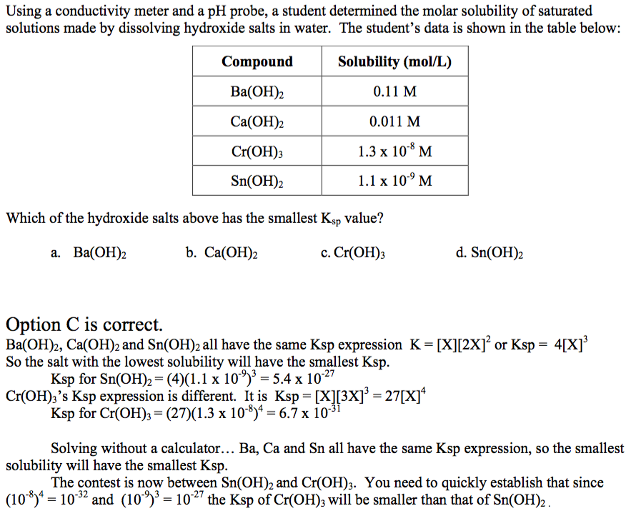
Find a K_{sp} from solubility data
Source
Video
Click reveals answer and explanation.
LO 6.22: The student can interpret data regarding solubility of salts to determine, or
rank, the relevant Ksp values.

Slide 26
Common Ion Effect
Source
The solubility of a sparingly soluble hydroxide can be greatly increased by the addition of an acid. For example, the hydroxide salt Mg(OH)₂ is relatively insoluble in water:
Mg(OH)_{2(s)} ⇌ Mg²⁺_{(aq)} + 2OH⁻_{(aq)} With Ksp=5.61×10⁻¹²
When acid is added to a saturated solution that contains excess solid Mg(OH)₂, the following reaction occurs, removing OH− from solution:
H⁺_{(aq)} + OH⁻_{(aq)}→H₂O_{(l)}
The overall equation for the reaction of Mg(OH)₂ with acid is thus
Mg(OH)_{2(s)} + 2H⁺_{(aq)} ⇌ Mg²⁺_{(aq)} + 2H₂O_{(l}) (18.7.7)
As more acid is added to a suspension of Mg(OH)₂, the equilibrium shown in Equation 18.7.7 is driven to the right, so more Mg(OH)₂ dissolves.
Video
In contrast, the solubility of a sparingly soluble salt may be decreased greatly by the addition of a common ion. For example, if MgCl₂ is added to a saturated Mg(OH)₂ solution, additional Mg(OH)₂ will precipitate out. The additional Mg²⁺ ions will shift the original equilibrium to the left, thus reducing the solubility of the magnesium hydroxide.
LO 6.23: The student can interpret data regarding the relative solubility of salts in terms of factors (common ions, pH) that influence the solubility.

Slide 27
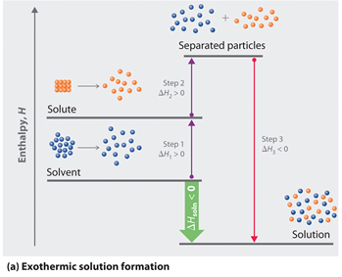
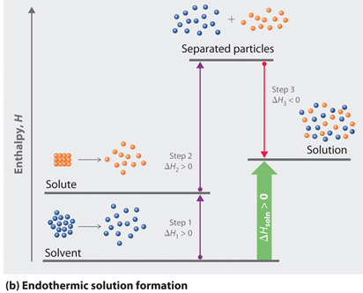
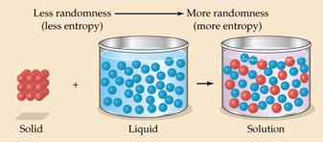
Salt dissolution: ∆H and ∆S
Source
The enthalpy (∆H_{soln}) of dissolution is dependent upon the intermolecular forces of the solute and solvent.
Video
Java Tutorial
The entropy (∆S_{soln}) of dissolution generally increases the disorder of the system.
LO 6.24: The student can analyze the enthalpic and entropic changes associated with the dissolution of a salt, using particulate level interactions and representations.

Slide 28
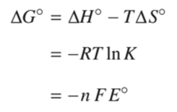
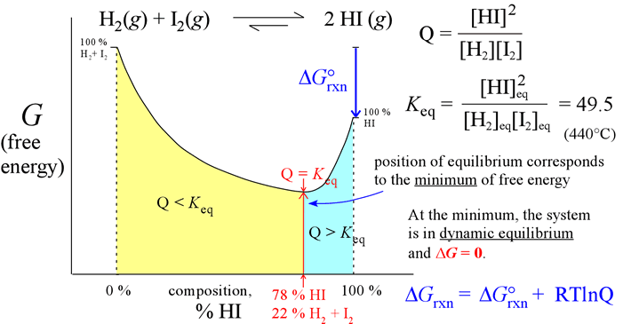
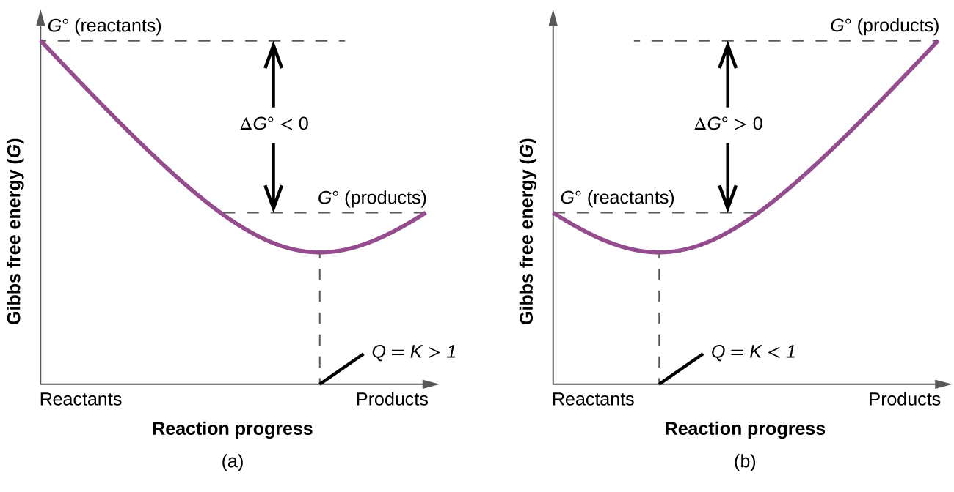
K, ∆G° and thermodynamic favorability
Source
G°_{reactants}
Video
∆G°rxn <0
Q=1,
m = ∆G
G°_{products}
Extent of Reaction
The key to understanding the relationship between ∆G° and K is recognizing that the magnitude of ∆G° tells us how far the standard-state is from equilibrium. The smaller the value of ∆G° , the closer the standard-state is to equilibrium. The larger the value of ∆G°, the further the reaction has to go to reach equilibrium.
LO 6.25: The student is able to express the equilibrium constant in terms of ∆G ° and RT and use this relationship to estimate the magnitude of K and, consequently, the thermodynamic favorability of the process.

Slide 29
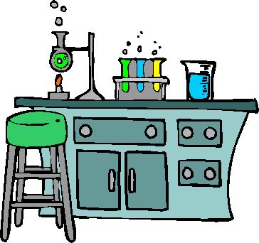
Science Practices
Laboratory Exercises

Slide 30
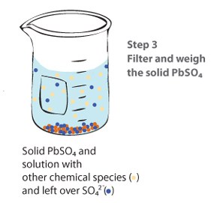
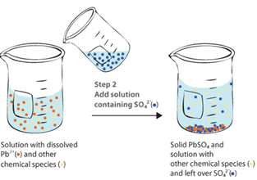
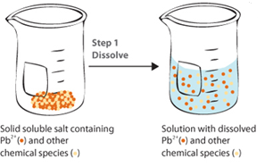
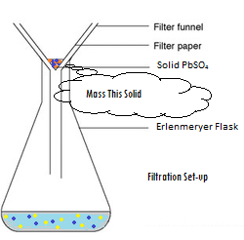
Gravimetric Analysis
Source
What It Determines:
  amount of analyte by mass measurements
  % composition
  empirical formulas
How It Can Be Done:
  Dehydration of a hydrate
  Forming a precipitate, which is then isolated and massed
Analysis:
  Remember to ALWAYS go to moles!
  use mole ratios to convert between various components
Video
Virtual Lab
Possible Source of Error | Contamination in solid | Incomplete Precipitation | Solid not fully dehydrated
Impact on Results | measured mass too large | Lose ion in filtrate – mass too small | measured mass too large
  Science Practices
  1.5 The student can re-express key elements of natural phenomena across multiple representations in the domain.
  2.2 The student can apply mathematical routines to quantities that describe natural phenomena.
  4.2 The student can design a plan for collecting data to answer a particular scientific question.
  5.1 The student can analyze data to identify patterns or relationships.
  6.1 The student can justify claims with evidence.
Learning Objectives
1.3: The student is able to select and apply mathematical relationships to mass data in order to justify a claim regarding the identity and/or estimated purity of a substance.
1.17: The student is able to express the law of conservation of mass quantitatively and qualitatively using symbolic representations and particulate drawings.
1.19: The student can design, and/or interpret data from, an experiment that uses gravimetric analysis to determine the concentration of an analyte in a solution.

Slide 31
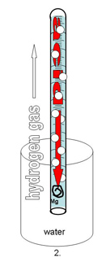
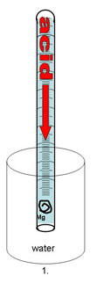
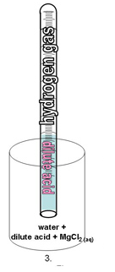
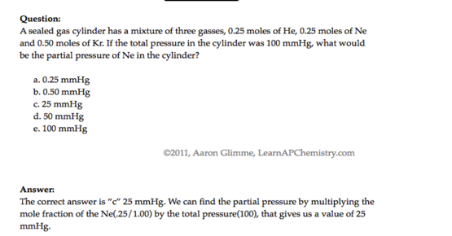
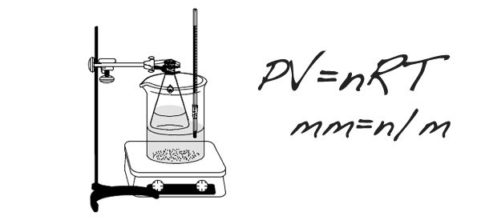

Gas Laws Labs
  After rxn, eudiometer lowered into water until levels equal so pressure inside room and tube are same
  Use Dalton’s Law to subtract P_{water}
  Sources of error:
    Mg left: moles of H₂ too low
    Air bubble at start: volume of gas too high
Source 1
Determination of Molar Mass of a Volatile Liquid
How It’s Done/Analysis:
  Volatile liquid heated until completely vaporized
  PV=nRT to solve for n:
    Temperature of water bath=T
    Small hole in stopper means Pressure = room pressure
    Volume=volume of flask
  Divide Mass of recondensed unknown by moles, compare to known molar mass to ID unknown
  Assume vapor completely recondenses
  →If lose vapor, then mass would be too low, and moles would be low
Determination of Molar Volume of a Gas
Source 2
Video 1
Video 2
Video 3
http://chemskills.com/?q=ideal_gas_law
Diffusion : Graham’s Law
Demo
How It’s Done/Analysis:
  Ends of glass tube plugged with soaked cotton
  White ring is NH₄Cl ppt
  Ppt will not be exactly in middle…
    Molar mass of NH₃ is lower than MM of HCl, so ring will be toward right side of tube
    Graham’s Law can be used to establish ratios which can be applied to distances
  Science Practices
  1.4 The student can use representations and models to analyze situations or solve problems qualitatively and quantitatively.
  2.2 The student can apply mathematical routines to quantities that describe natural phenomena.
  2.3 The student can estimate numerically quantities that describe natural phenomena.
  6.4 The student can make claims and predictions about natural phenomena based on scientific theories and models.
Learning Objectives
LO 2.4: The student is able to use KMT and concepts of intermolecular forces to make predictions about the macroscopic properties of gases, including both ideal and nonideal behaviors.
LO 2.6: The student can apply mathematical relationships or estimation to determine macroscopic variables for ideal gases.

Slide 32
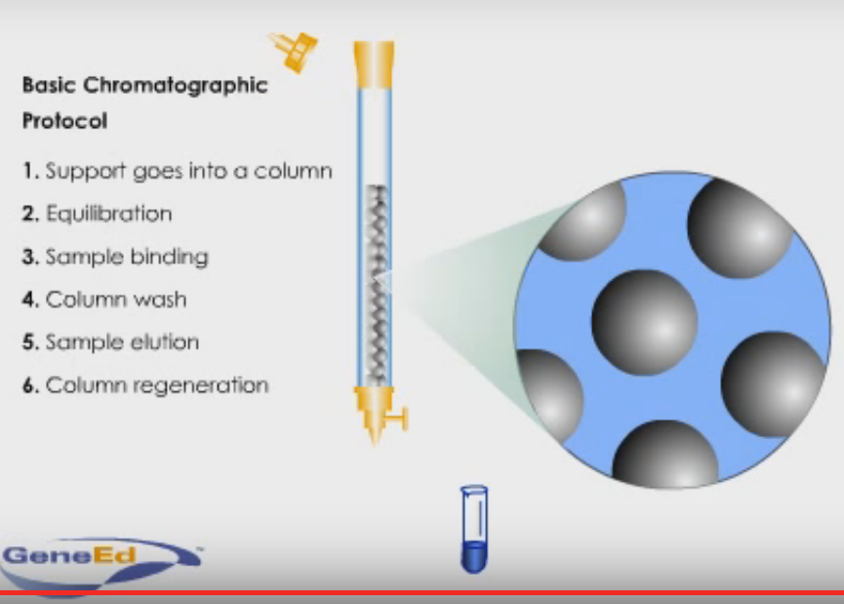

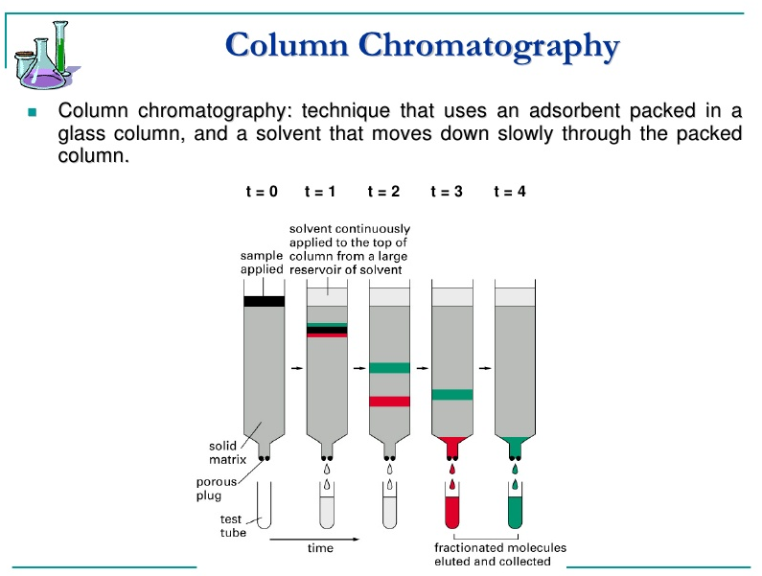
Chromatography
Click here to watch animation explaining column chromatography
Source
Video
Virtual Lab
Source (includes nice discussion of biological applications)
Main Error:
  Incomplete Separation
Can be caused by:
  Inconsistent spotting
  Overloading
  Improper packing (column)
  Poor solvent choice
Advantage: We can collect and use the fractions
  Science Practices
  4.2 The student can design a plan for collecting data to answer a particular scientific question.
  5.1The student can analyze data to identify patterns or relationships.
  6.2 The student can construct explanations of phenomena based on evidence produced through scientific practices.
Learning Objectives
LO 2.7: The student is able to explain how solutes can be separated by chromatography based on intermolecular interactions.
LO 2.10: The student can design and/or interpret the results of a separation experiment (filtration, paper chromatography, column chromatography, or distillation) in terms of the relative strength of interactions among and between the components.

Slide 33

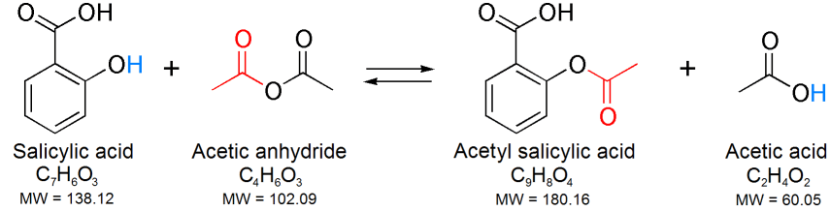
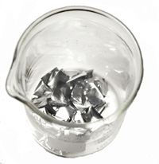











Synthesis
Source
Inorganic Synthesis Examples:
  Synthesis of Coordination Compound
  Synthesis of Alum from aluminum
Organic Synthesis Example:
  Synthesis of Aspirin
Syntheses are done in solution, and require purification by filtration, recrystalization, column chromatography or a combination
% Yield is calculated; analysis is done by melting point, NMR, IR
Video
Virtual Lab
Synthesizing Alum Procedure:
Source of aluminum is reacted with KOH
Possible Error Sources: impurity in Al (such as plastic coating) prevents complete rxn
H₂SO₄ is added to ppt Al(OH)₃
Possible Error Sources: incomplete precipitation
Mixture heated until no Al(s) is left
Possible Error Sources: some Al(s) remains undissolved
Filter and collect alum crystals
Possible Error Sources: crystals escape to filtrate, crystals not washed well and remain wet
Recrystallize alum in ice bath
Possible Error Sources: crystals form too quickly, incomplete recrystallization
  Science Practices
  2.1 The student can justify the selection of a mathematical routine to solve problems.
  2.2 The student can apply mathematical routines to quantities that describe natural phenomena.
  4.2 The student can design a plan for collecting data to answer a particular scientific question.
  6.1 The student can justify claims with evidence.
Learning Objectives
LO 3.5: The student is able to design a plan in order to collect data on the synthesis or decomposition of a compound to confirm the conservation of matter and the law of definite proportions.
LO 3.6: The student is able to use data from synthesis or decomposition of a compound to confirm the conservation of matter and the law of definite proportions.
LO:

Slide 34









Titration- Acid/Base
Source 1
Assumption: Endpoint is equivalence point
  This is not true – we actually “overshoot” before indicator changes
Possible Sources of Error:
  Overshoot Endpoint
    Moles of titrant (and therefore analyte) too high
  Not reading to bottom of meniscus
    Moles of titrant too low
  Concentration of titrant not what expected
    Be sure to rinse buret with titrant first to control for this
Source 2
Video
Source
Virtual Lab
Strength of Acids affects shape of graph:
Polyprotic acids have multiple end points:
  Science Practices
  1.4 The student can use representations and models to analyze situations or solve problems qualitatively and quantitatively.
  5.1 The student can analyze data to identify patterns or relationships.
Learning Objectives
LO 6.12: The student can reason about the distinction between strong and weak acid solutions with similar values of pH, including the percent ionization of the acids, the concentrations needed to achieve the same pH, and the amount of base needed to reach the equivalence point in a titration.
LO 6.13: The student can interpret titration data for monoprotic or polyprotic acids involving titration of a weak or strong acid by a strong base (or a weak or strong base by a strong acid) to determine the concentration of the titrant and the pKa for a weak acid, or the pKb for a weak base.

Slide 35








REDOX Titration
Source 1
Endpoint can be determined by potentiometer:
Or REDOX indicator:
Applications/Methods of REDOX Titrations:
Or an indicator that shows the presence of a particular species:
Vitamin C Content
Concentration of a redox species
Back Titrations
Video
Virtual Lab
Source
Starch indicates presence of iodine
Source
Source
Done when the endpoint can be hard to ID – add an excess, and then back titrate to determine how much is in excess
  Science Practices
  4.2 The student can design a plan for collecting data to answer a particular scientific question.
  5.1 The student can analyze data to identify patterns or relationships.
Learning Objectives
LO 1.20: The student can design, and/or interpret data from, an experiment that uses titration to determine the concentration of an analyte in a solution.
LO 3.9: The student is able to design and/or interpret the results of an experiment involving a redox titration.

Slide 36







Kinetics
Virtual Lab 1
Virtual Lab 2
Video
Source 1
Using Spectrometry:
Data:
  Analysis
    rate law from straight-line graph
    k from integrated rate law
    E_{a} from Arrhenius Equation
Clock Reactions
  Reactions that have a delayed physical change due to mechanism which only has a later step show color change
  Concentration vs. time data can be gathered
    It is important that there is a relatively low [S₂O₃⁻] so that the I₃⁻ will accumulate and show the color change
Time (s)
Zero Order Plot | 1st Order Plot | 2nd Order Plot
Blue in the presence of starch
  Science Practices
  2.1 The student can justify the selection of a mathematical routine to solve problems.
  2.2 The student can apply mathematical routines to quantities that describe natural phenomena.
  5.1 The student can analyze data to identify patterns or relationships.
Learning Objectives
LO 4.2: The student is able to analyze concentration vs. time data to determine the rate law for a zeroth-, first-, or second-order reaction.
LO 4.3: The student is able to connect the half-life of a reaction to the rate constant of a first-order reaction and justify the use of this relation in terms of the reaction being a first-order reaction.

Slide 37



Calorimetry
Application of Law of Conservation of Energy: All heat produced/consumed during reaction (system) is exchanged with the surroundings.
Source 1
Applications:
Coffee Cup Calorimeter
Assumption:
the calorimeter is isolated
so the surroundings are only the calorimeter setup, which includes the water
the calorimeter itself has a heat capacity, as it will absorb some heat.
So…
q_{surr} = -q_{rxn}
q_{surr} = q_{cal}+q_{H2O+sys}
q_{cal} = CcalΔT
Therefore:
-q_{rxn}= C_{cal}ΔT + m_{H2O+sys}cΔT
Then we can use q_{rxn} find ΔH_{rxn}:
ΔH_{rxn} =q_{rxn}/mol_{react}
Specific Heat of Material
  Can be used to ID unknown
Heat of reaction
Energy content of food
  This is usually done in a bomb calorimeter (constant V)
Video
Virtual Lab
  Constant P
Source
Source
  Science Practices
  1.4 The student can use representations and models to analyze situations or solve problems qualitatively and quantitatively.
  2.2 The student can apply mathematical routines to quantities that describe natural phenomena.
  4.2 The student can design a plan for collecting data to answer a particular scientific question.
  5.1 The student can analyze data to identify patterns or relationships.
Learning Objectives
LO 5.4: The student is able to use conservation of energy to relate the magnitudes of the energy changes occurring in two or more interacting systems, including identification of the systems, the type (heat versus work), or the direction of energy flow.
LO 5.7: The student is able to design and/or interpret the results of an experiment in which calorimetry is used to determine the change in enthalpy of a chemical process (heating/cooling, phase transition, or chemical reaction) at constant pressure.

Slide 38




Qualitative Analysis
Virtual Lab 1
Virtual Lab 2
Video
Source
Remember that the lower the K_{sp}, the less soluble the substance. Qualitative analysis then also allows a ranking of salts by K_{sp}, and demonstrates the effect of pH on solubility.
  Science Practices
  2.2 The student can apply mathematical routines to quantities that describe natural phenomena.
  2.3 The student can estimate numerically quantities that describe natural phenomena.
  5.1 The student can analyze data to identify patterns or relationships.
  6.4 The student can make claims and predictions about natural phenomena based on scientific theories and models.
Learning Objectives
LO 6.21: The student can predict the solubility of a salt, or rank the solubility of salts, given the relevant Ksp values.
LO 6.22: The student can interpret data regarding solubility of salts to determine, or rank, the relevant Ksp values.
LO 6.23: The student can interpret data regarding the relative solubility of salts in terms of factors (common ions, pH) that influence the solubility.

Slide 39

Now…
Just for Fun:
Some “Harry” Problems

Slide 40
2Fe(OH)₃ (s) + 3H₂SO₄ (aq) à Fe₂(SO₄)₃ (aq) + 6H₂O (l)
a. Ron Weasley had to perform the above reaction in Professor Snape’s potions class. Ron mixed 45.0 g iron III hydroxide with 45.0 ml 2.00 M sulfuric acid in a cauldron, leaving the lid off. The heat capacity of his cauldron was 645 J/K.
i. What other information would Ron need to know or measure experimentally to determine the molar change in enthalpy of the reaction, ∆H°rxn?
ii. Unbeknownst to Ron, Draco Malfoy dropped a 100 g sneakoscope (assume this is unreactive and at room temperature) into Ron’s cauldron before Ron measured his temperature but after the reaction was initiated. Explain in which direction this would alter Ron’s experimental value of ∆H°rxn.
b. Hermione Granger also performed this reaction. She mixed 45.0 g iron III hydroxide with 450 ml 2.00 M sulfuric acid in her cauldron, and kept the lid on, using a spell to enable her to measure temperature (revelio thermo).
i. How would you expect her temperature change to differ from Ron’s, if at all? For this comparison, assume that Ron’s reaction was performed with the lid on and with no sneakoscope.
ii. Hermione repeated the experiment using all the same measurements, but used aluminum hydroxide instead of iron III hydroxide. Assuming that both reactions have the same ∆H°rxn, would her temperature change be smaller, the same, or greater in her second experiment.
c. Given the following values for absolute entropies, what would ∆S°rxn be?

Slide 41
Just for Fun… Answers
ai. q_{rxn} = -(C_{cal}∆T + c_{(mixture)}m_{(mixture)}∆T); ∆H°rxn = q_{rxn} / moles rxn
Ron would need to measure the starting and final temperatures, know (or measure) the specific heat capacity and mass of the reaction mixture, and the number of moles of reaction. In this case,
45.0 g Fe(OH)₃ / 106.8 g/mole = 0.421 moles; 0.045 L x 2 M = 0.09 moles H₂SO₄ (limiting), so 0.03 moles reaction (to those who dislike this concept, I apologize).
bii. 45.0 g Al(OH)₃ / 78 g/mole = 0.577 mole. This is still limiting, but now there are about 0.288 moles of reaction, so more heat is produced. As the total mass doesn’t change, and the specific heat capacity is unlikely to change dramatically, it is reasonable to predict that ∆T would be larger.
aii. Because the sneakoscope would absorb heat, ∆T would be lower, so the heat of the reaction would appear to be lower as would ∆H°rxn.
c. ∆S°rxn = sum product S° - sum reactant S°
∆S°rxn = 6(69.91) + 2(-315.9) + 3(20.1) – 2(107) – 3(20.08) = -426.3 J/mole*K.
bi. For Hermione, the Fe(OH)₃ is now limiting, as there are now 0.9 moles H₂SO₄. So, there are more moles of reaction, about 0.21, a seven-fold increase. This would increase the temperature change. However, there is also a significant increase in mass of the reaction mixture, from about 90 g to 500 g. This would decrease the temperature change. So the exact ∆T outcome, increase or decrease, depends on the specific heat capacity of the reaction mixture.

